Slide 1
Java ByteArrayOutputStream class
Java ByteArrayOutputStream class is used to write data into multiple files. In this stream, the data is written into a byte array that can be written to multiple streams.
The ByteArrayOutputStream holds a copy of data and forwards it to multiple streams.
The buffer of ByteArrayOutputStream automatically grows according to data.
Closing a ByteArrayOutputStream has no effect. The methods in this class can be called after the stream has been closed without generating an IOException.
FileOutputStream
myfile2.txt
Write
Peter is going to India
ByteArrayOutputStream
Write
Java Application
Write
FileOutputStream
myfile1.txt
Write
Write
Peter is going to India

Slide 2
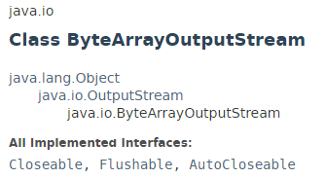
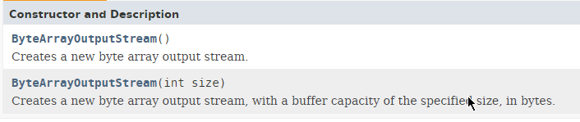
Java ByteArrayOutputStream class

Slide 3
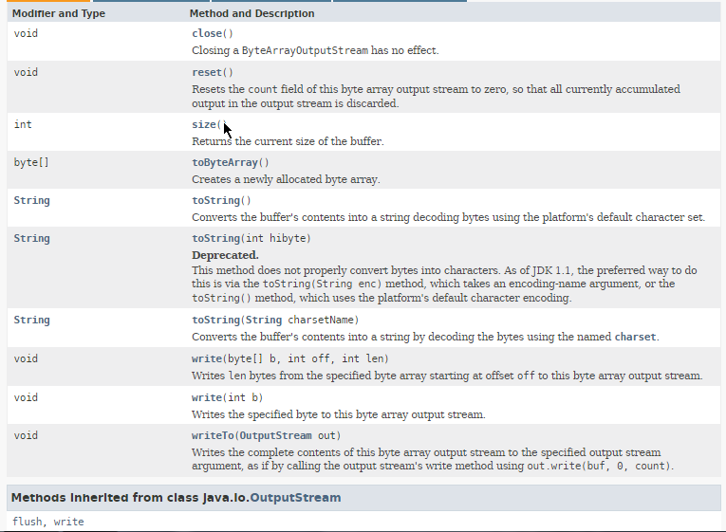
Java ByteArrayOutputStream class

Slide 4
Java ByteArrayOutputStream class
https://docs.oracle.com/javase/8/docs/api/index.html?java/io/ByteArrayOutputStream.html

